Slide 1
PRELIMINARY DRAFT
Flight Path Frequency Analysis
Question For a given geographic area, how frequently are aircraft passing overhead (the time between one aircraft and the next aircraft)? Has this frequency changed?
Data Source 3D radar data from the KHPN ANOMS system. This data records a 3D data stream for every aircraft arriving and departing from KHPN.
Analysis
Define a geo-fenced box within the data
Determine all aircraft passing through this box below a defined altitude (3,500 ft MSL used in this analysis)
3. Calculate the elapsed time in seconds between each aircraft and the next aircraft passing through the box. Use 900 seconds (15 minutes) as the max time recorded for each interval (for simplifying the histograms in step 4)
Create histograms for these time distributions and calculate the 25/50/75th percentiles
Data source: KHPN ANOMS radar data; Code at https://github.com/nthartman/KHPN_Traffic_Frequency

Slide 2
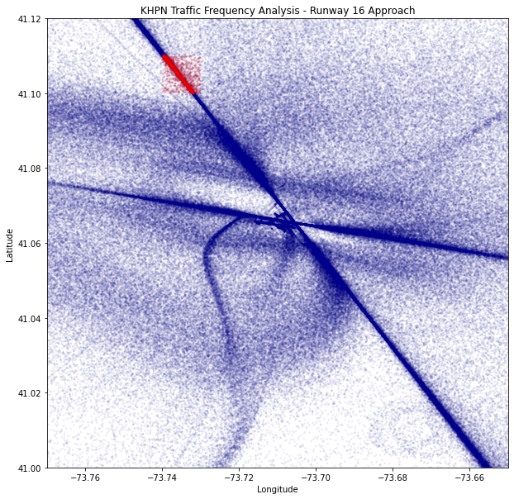
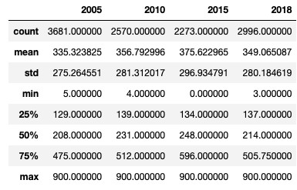
PRELIMINARY DRAFT
Analysis 1: Runway 16 Approach
Analysis for August of each year; time in seconds (max is 900)
Data source: KHPN ANOMS radar data; Code at https://github.com/nthartman/KHPN_Traffic_Frequency

Slide 3
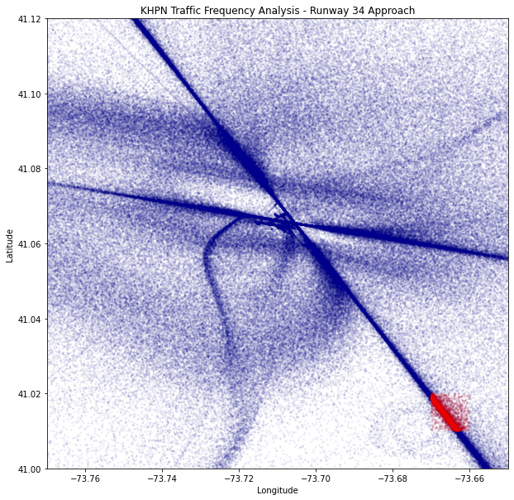
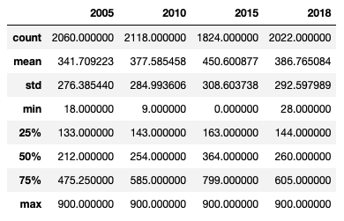
PRELIMINARY DRAFT
Analysis 3: Runway 34 Approach
Analysis for August of each year; time in seconds (max is 900)
Data source: KHPN ANOMS radar data; Code at https://github.com/nthartman/KHPN_Traffic_Frequency

Slide 4
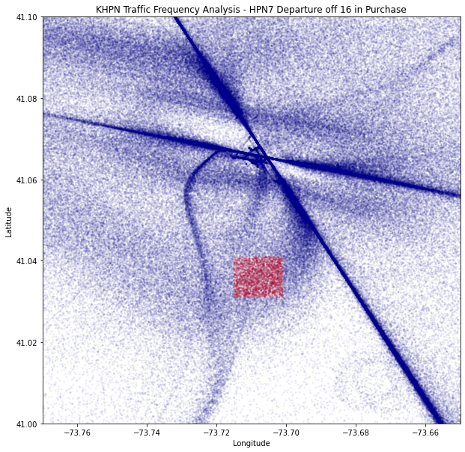
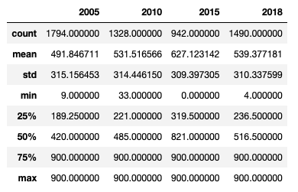
PRELIMINARY DRAFT
Analysis 3: Runway 16 Departure (HPN 7 Departure near Purchase St. and Anderson Hill Rd)
Analysis for August of each year; time in seconds (max is 900)
Data source: KHPN ANOMS radar data; Code at https://github.com/nthartman/KHPN_Traffic_Frequency

Slide 5
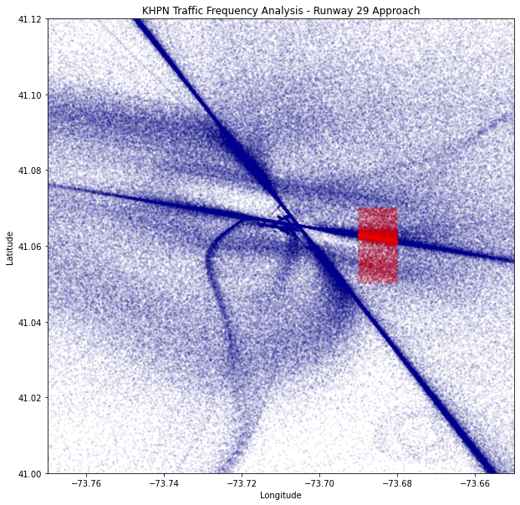
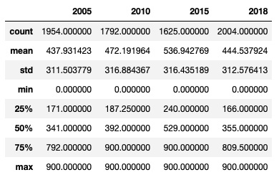
PRELIMINARY DRAFT
Analysis 4: Runway 29 Approach
Analysis for August of each year; time in seconds (max is 900)
Data source: KHPN ANOMS radar data; Code at https://github.com/nthartman/KHPN_Traffic_Frequency

Slide 6
PRELIMINARY DRAFT
Appendix: KHPN Total Aircraft Operations
Data source: KHPN ANOMS radar data; Code at https://github.com/nthartman/KHPN_Traffic_Frequency

